Slide 1
AUGMENTED REALITY
(AR)
Prepared By:
Eshwanth B

Slide 2
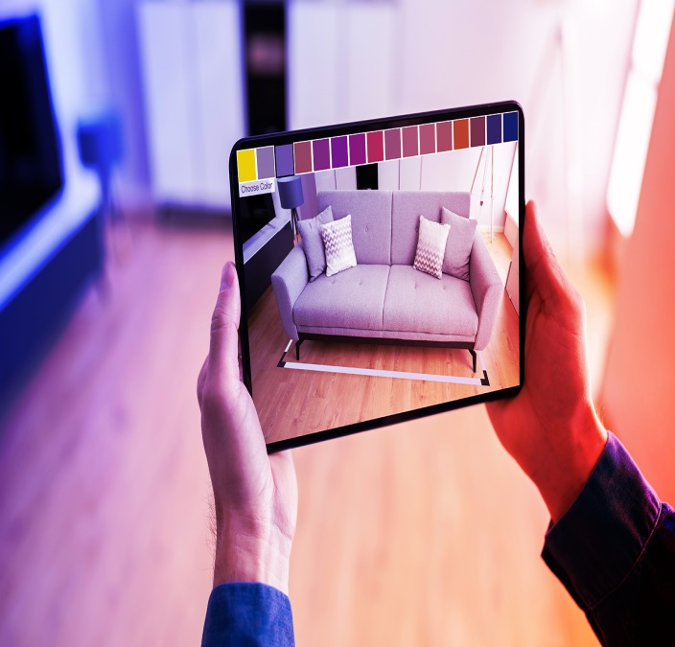
What Is augmented reality?
Augmented Reality (AR) is an interactive experience that combines that Real World and Computer Generated Content.
History of AR: In 1990, Boeing researcher Tom Caudell coined the term “Augmented Reality”.
Two years later, Louis Rosenberg established the First entirely immersive AR System at the U.S. Air Force Research Laboratory.
Infact, Augmented Reality Technology was invented in 1968, with Ivan Sutherland’s Development. However, the term “Augmented Reality” wasn’t coined until 1990 by Being researcher Tom Caudell.

Slide 3

THE ULTIMATE GOAL OF AR
To enhance a person’s performance and perception of the world.
To create a system such that a user cannot tell the difference between the Real World and the Virtual Augmentation of it.

Slide 4
Difference Between Augmented & Virtual Reality
AUGMENTED REALITY | VIRTUAL REALITY
AR uses a Real-World Setting | VR is completely virtual
AR users can control their presence in the Real World | VR users are controlled by the System
AR can be accessed with a Smartphone | However, VR requires a Headset Device
AR enhances both the Virtual and Real World | VR only enhances a Fictional Reality

Slide 5
How Does It Work?
Using a mobile application, a mobile phone’s camera identifies and interprets a marker, often a black and white barcode image.
The software analyses the marker and creates a virtual image overlay on the mobile phone’s screen, tied to the position of the camera.
This means the app works with the camera to interpret the angles and distance the mobile phone is away from the marker.

Slide 6
IMPLEMENTATION FRAMEWORK
HARDWARE:
To make the System to be as lightweight and comfortable as possible, Off-The-Shelf Hardware can be used to avoid the expense, effort and time involved in building our own.
SOFTWARE:
Software Infrastructure Coterie, a prototyping environment that provided Language- Level support for the distributed Virtual Environment.

Slide 7
DISPLAY TECHNOLOGIES
Monitor Based Display
Head Mounted Displays(HMD):
There are Two Types:
-> Video See-Through
-> Optical See-Through

Slide 8
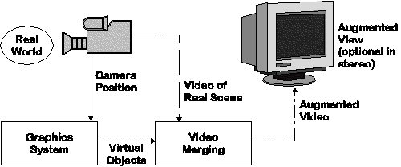
Monitor Based Augmented Reality:
Simplest Available
Little feeling of being immersed in environment.

Slide 9
Head Mounted Displays (HMD)
Video-See Through HMD:
Video-See Through Systems present video feeds from Cameras inside Head-Mounted Devices. This is the Standard Method that Phones for example use AR with.
Optical-See Through HMD:
An Optical-See Through System allows user to see the Real World and a Virtual Environment simultaneously by applying a mirror that is partially Transmissive and Partially Reflective.

Slide 10
APPLICATION:
1. Medical
2. Entertainment
3. Millitary Training
4. Engineering Design
5. Robotics and TeleRobotics
6. Manufacturing, Maintenance and
Repair
7. Consumer Design
8. Hazard Detection
9. Annotation & Visualization
10. Robot Path Planning

Slide 11
ADVANTAGES:
Can increase Knowledge and Information.
People can share experience with each other in real time over long distances.
Games that provide an even more “Real” Experiences.
Things come to life on People’s Mobile Phones.

Slide 12
DIS-ADVANTAGES:
1. Spam and Securit
2. Social and Real Time Vs Solitary and Cached.
3. UX (User Experience): Using
AR can be inappropriate in social situations.
4. Openness: Other people can develop their own layers of content to display.

Slide 13
CONCLUSION:
Thus, Augmented Reality (AR) is the Future Technology That Will Revolutionize The World and Allow Companies To Gain a Market Advantage.
AR Has Amazing Applications That Can Very Well Allow Us To Live Our Lives More Productively, More Safely and More Informatively.
XXX

Slide 14
THANK YOU

